Slide 1
Spirit of Saginaw High School Band

Slide 2
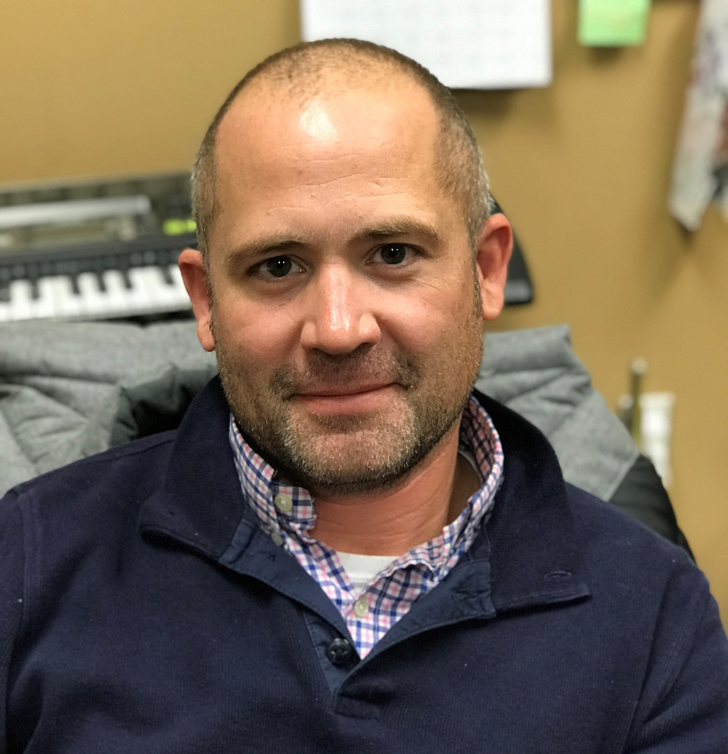
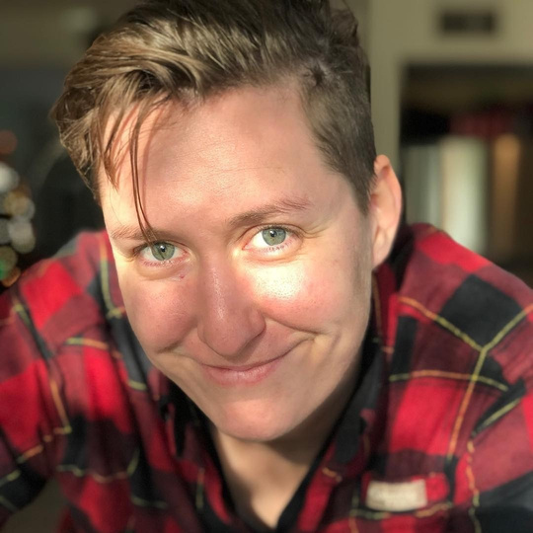
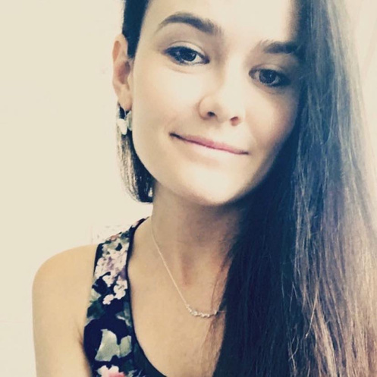
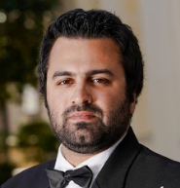
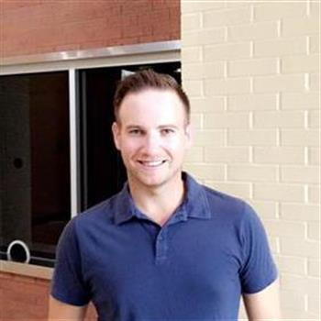
DIRECTOR TEAM
Matt Pearson - Director of Bands - mpearson@ems-isd.net
Alyson Holley - Associate Director of Bands - aholley@ems-isd.net
Jenn Giba - Assistant Director & Director of Percussion - jgiba@ems-isd.net
Jesse Rajabi - Assistant Director - jrajabi@ems-isd.net
Art Grossman - Color Guard Director - agrossman@marching365.com

Slide 3
ABOUT US
The Spirit of Saginaw Band program consists of approx. 200 students who are involved in one or more of our performing ensembles:
Marching Band
Wind Ensemble
Symphonic Band
Concert Band
Jazz Band
Drumline/Indoor Drumline/Percussion Ensemble
Color Guard/Winter Guard
All students are in the Spirit of Saginaw Band Program
Every student participates in both Marching Band & a Spring Ensemble
Informal auditions for class period placement take place April 18-20
Read More

Slide 4
WHY JOIN US
PE Credit
Fine Arts Credit
Traits & Skills that will help you to be hireable in any future career:
Goal Setting
Work Ethic
Responsibility
Time Management
Leadership
Discipline
Family & Team Work
Diligence
Body Awareness & Health
Life-long Friendships
A Home with people who care about you!
"I could go on...I don't pay for band. I pay for the opportunities that band provides my kids with to develop attributes that will serve them well throughout their lives and give them the opportunity to bless the lives of others. From what I have seen so far, I think it is a great investment!"

Slide 5
Question
01
I don't know how to march! Can I do band?
YES! Did you know how to play your instrument before beginner band? We will teach you to march!

Slide 6
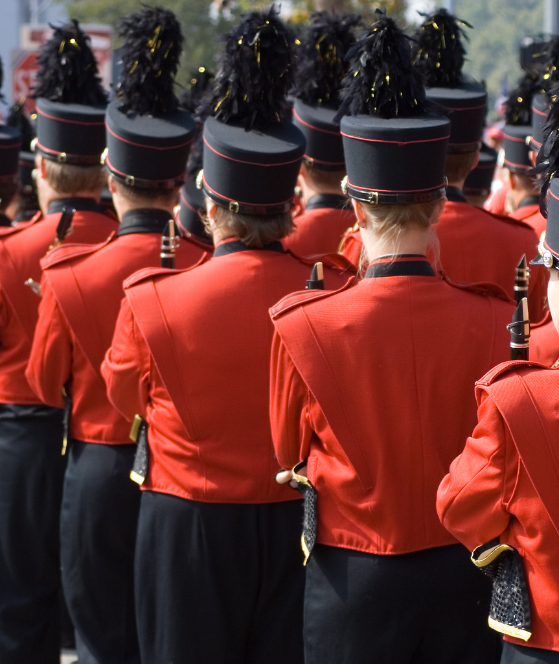
MARCHING BAND
01.
Competition Spot
Every student is in the Marching Band!
Each student will audition for their position in August.
All students will:
Attend Summer Band Camp
Attend all Home & Away football games
Perform in the stands and at half time for the Star Steppers at all home & away football games.
March a Friday Night spot
Attend all Saturday Competitions
Attend all scheduled marching band rehearsals during the school year.
Oftentimes older classmen. Will march & play the marching show.
Not enrolled in any class/activty that interferes with morning rehearsal schedule or performance schedule
02.
Visual Ensemble
Oftentimes younger classmen who still need work on marching fundamentals. Will help with visual content of the marching show.

Slide 7
RESOURCES AT YOUR FINGERTIPS
With a large program, there is ALWAYS information available to you.
Help us help you by searching, bookmarking, and following our platforms.
Band Website
Remind Account
https://www.emsisd.com/Page/1632
https://www.emsisd.com/Page/23890
Booster Website
Growing Up
https://spiritofsaginawband.com
@Saginaw Band Boosters (FB)
@spiritofsaginaw (Insta)
@SpiritofSaginaw (Twitter)

Slide 8
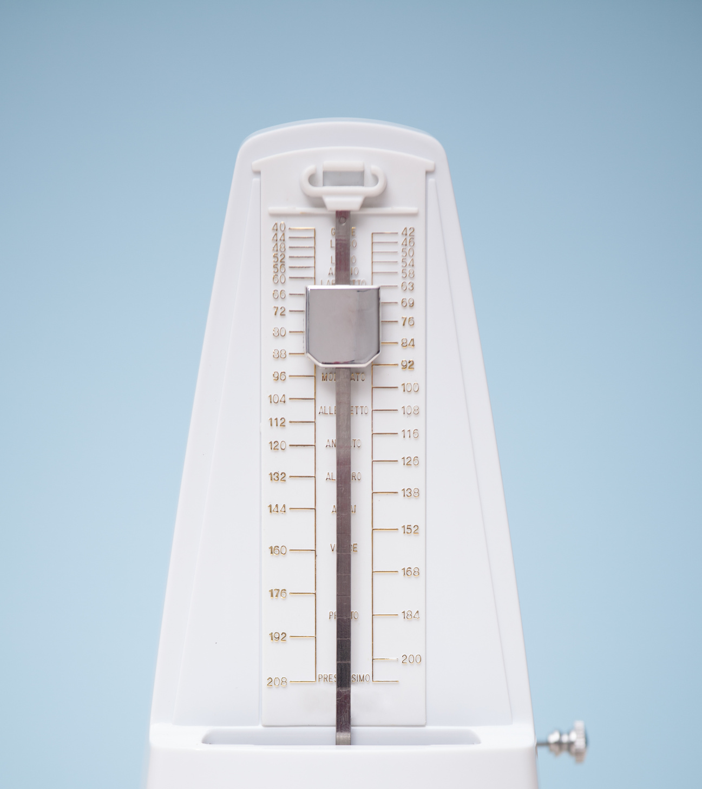
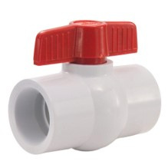
Items You Need for Band
Black 3-Ring Binder with Sheet Protectors
Tuner with Peterson Tuning Pick-Up Clip OR TE Tuner on Cell Phone
Breathing Tube (1/4" diameter) PVC Tube with valve from Hardware Store
Solid Black UnderArmour Compression shirt & shorts
LONG Black Socks

Slide 9
Percussion Equipment
4 Matching Yarn Marimba Mallets
1 Pair Concert Snare Sticks
1 Pair Marching Snare Sticks
1 Pair Timpani Mallets
Mallet Bag - with name on it!

Slide 10
Woodwind Equipment
5 Reeds, rotated daily
Legere Transparent reed for marching band (clarinet & sax)
Flute with B-flat Footjoint
Clarinet 5RV Mouthpiece & Bonade Inverted Ligature
Saxophone Optimum AL3 Mouthpiece & Ligature
2-3 Oboe/Bassoon Reeds
Brass Equipment
Trumpet Bach 3 Mouthpiece
Step-up horn: Intermediate to Professional model recommended
Horn Holton Farkas MDC Mouthpiece
Trombone Bach 5G Mouthpiece
Step-up horn with Large Bore F attachment
Euphonium Bach 5G Mouthpiece
Tuba Miraphone TU33 or equivalent mouthpiece

Slide 11
Other items you'll need on your SOS Band Adventure!
Always arrive atleast 15 minutes early to any rehearsal
Water Jug filled with H2) - Put your name on it
Sunglasses, Hat, Sunscreen, Athletic clothing for marching band
Instrument, Music, Pencil, Highlighter for all rehearsals/classes
UnderArmour compression shirt & shorts for under marching band uniform
Long Black Socks
Concert Clothing = "Tuxedo" look - Black Dress Pants (NOT JEANS), White Dress Shirt, Black Sport Coat, Black Bow Tie, Black socks & Dress shoes
Black Dress/Outfit - Arms & Legs covered

Slide 12
Your
Logo
PRIVATE LESSONS
This is the BEST way to become better at your instrument.
Scholarships available to those who qualify.
All our teachers are professionals on their instruments!
Increase Skills
More Connections

Slide 13
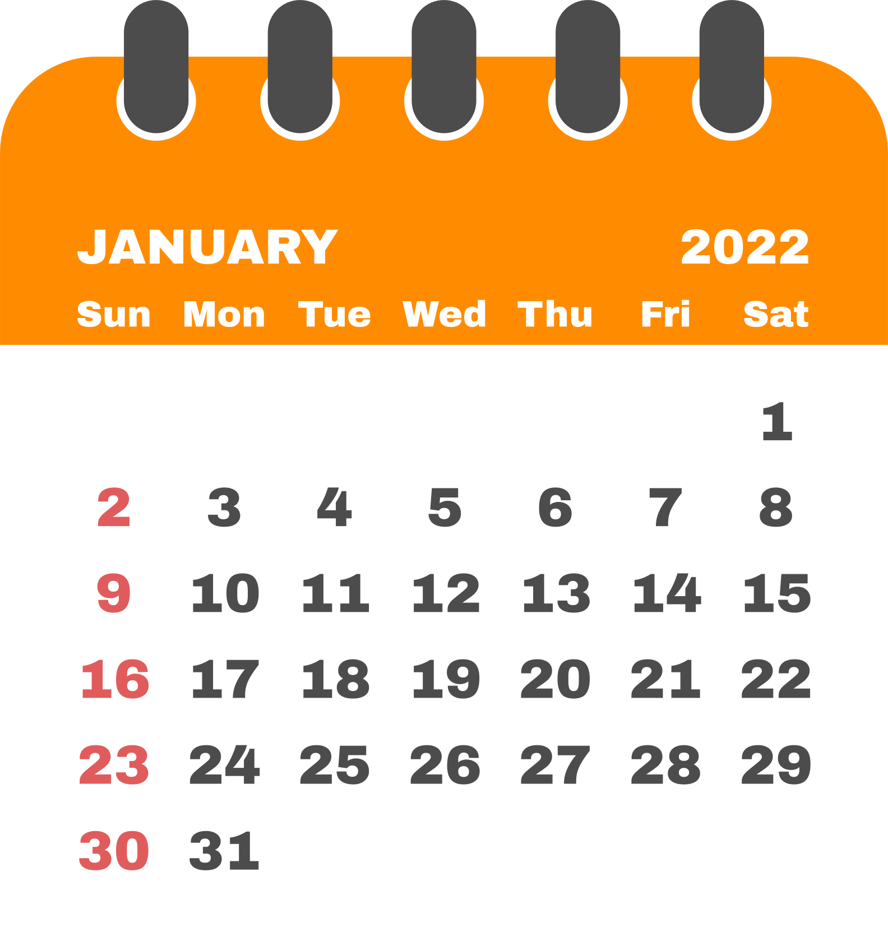
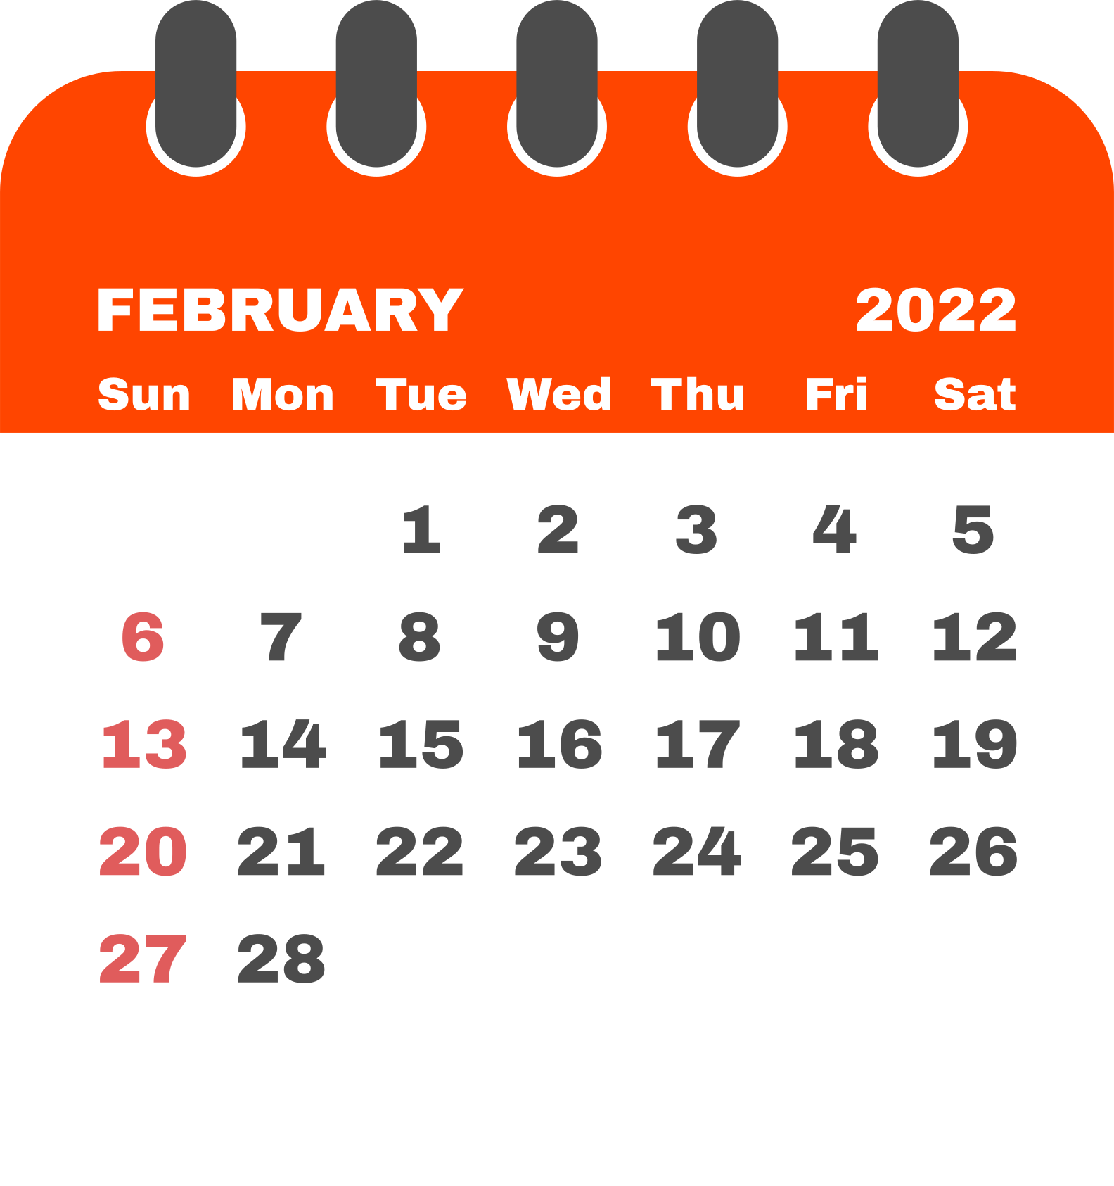
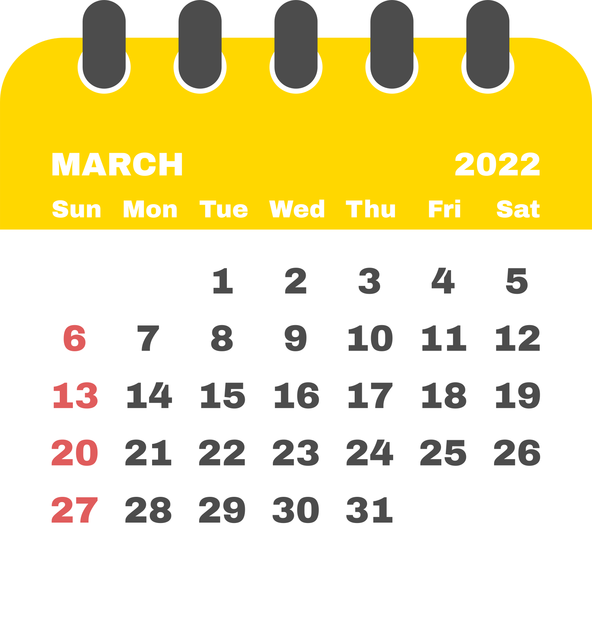
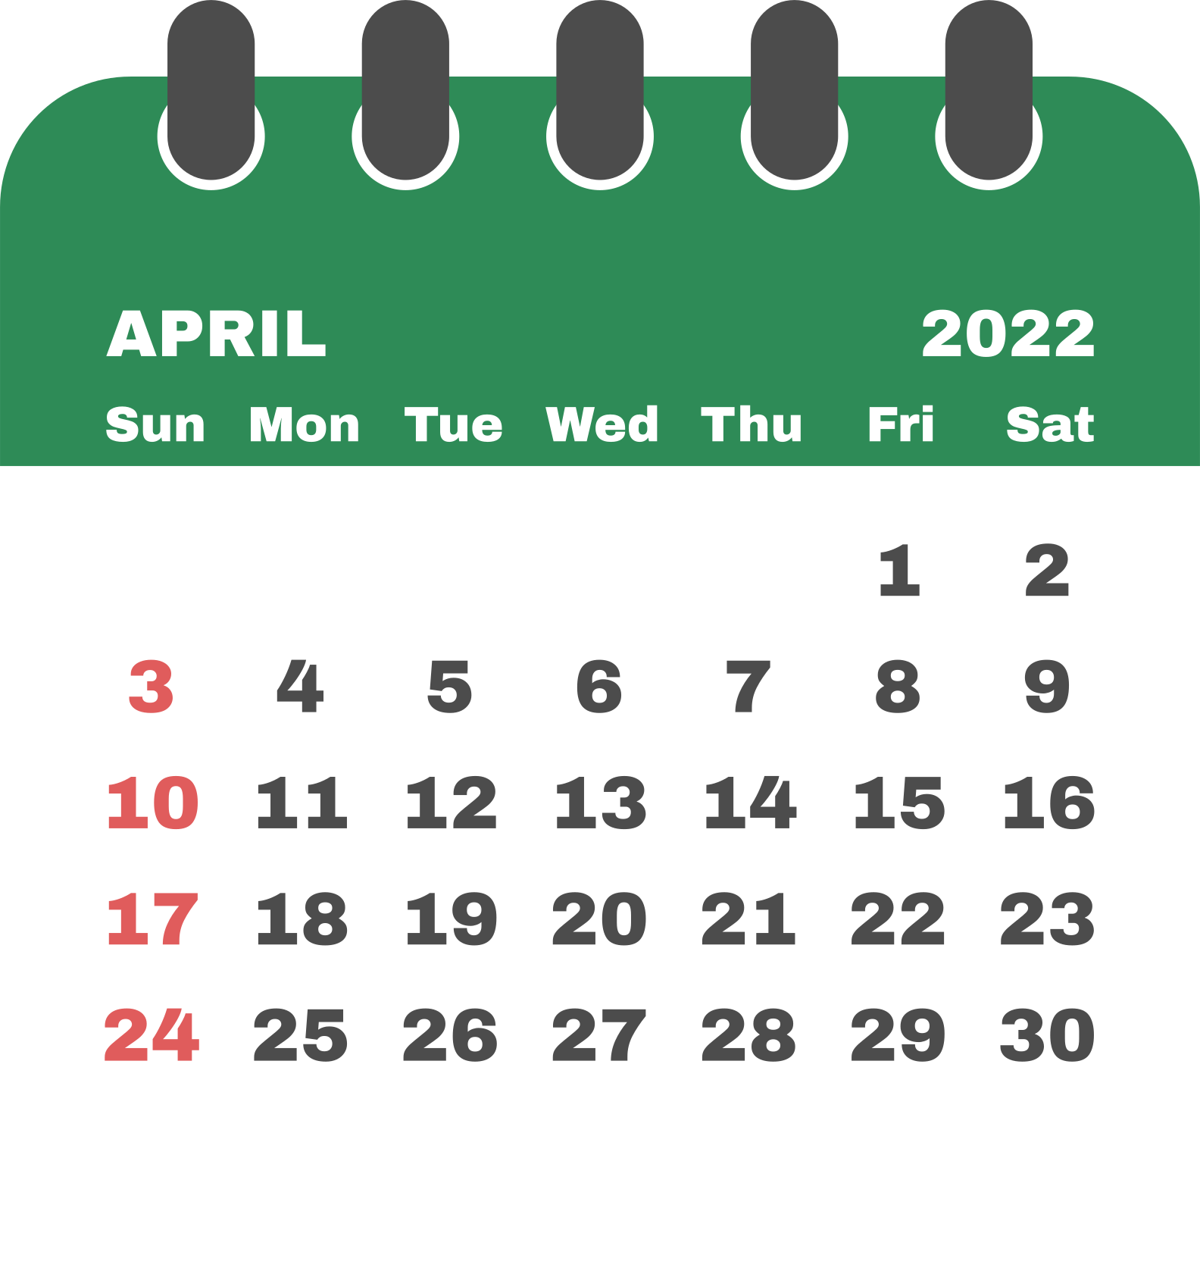
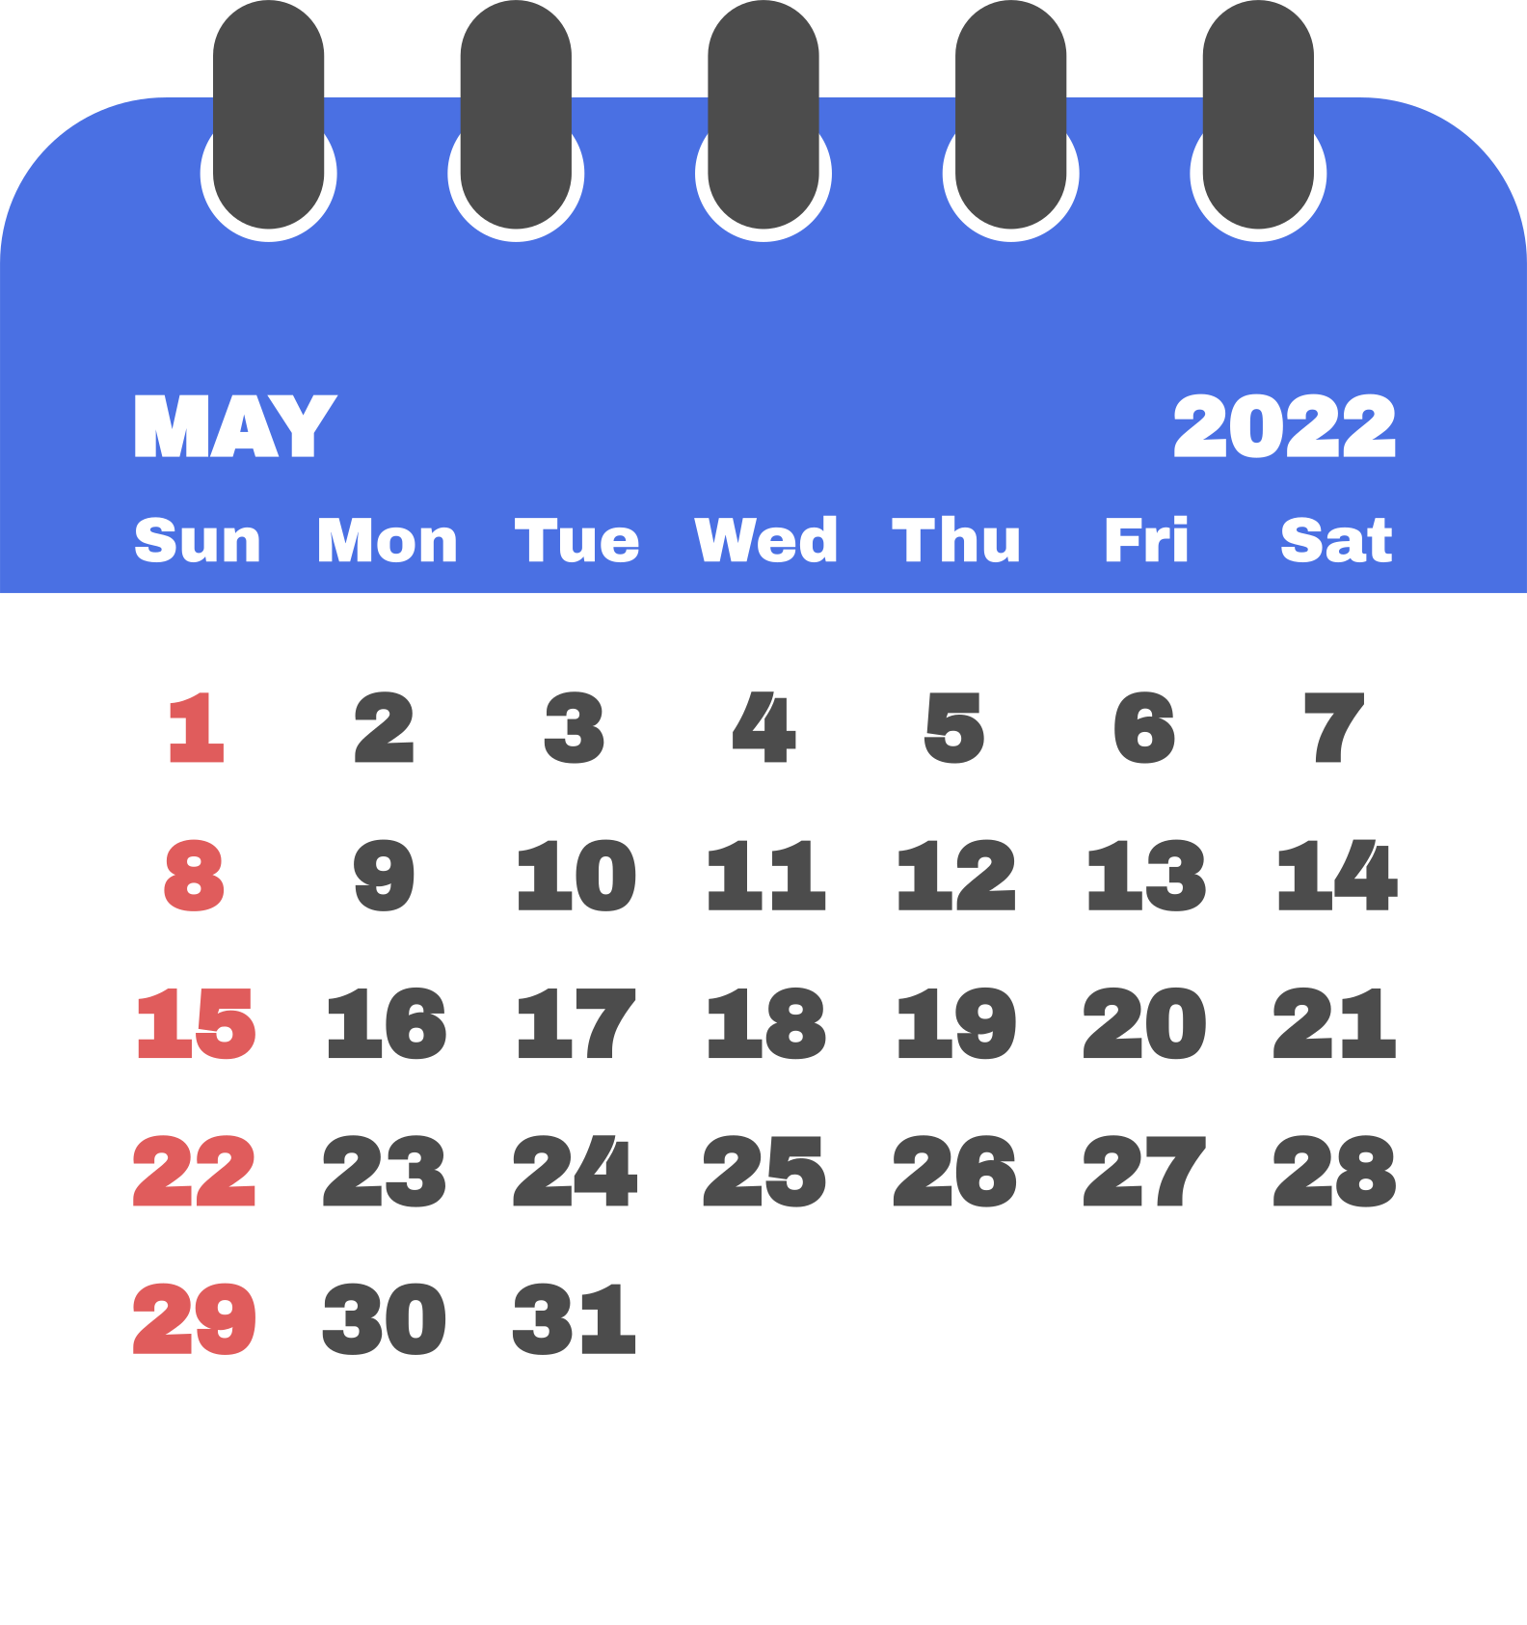
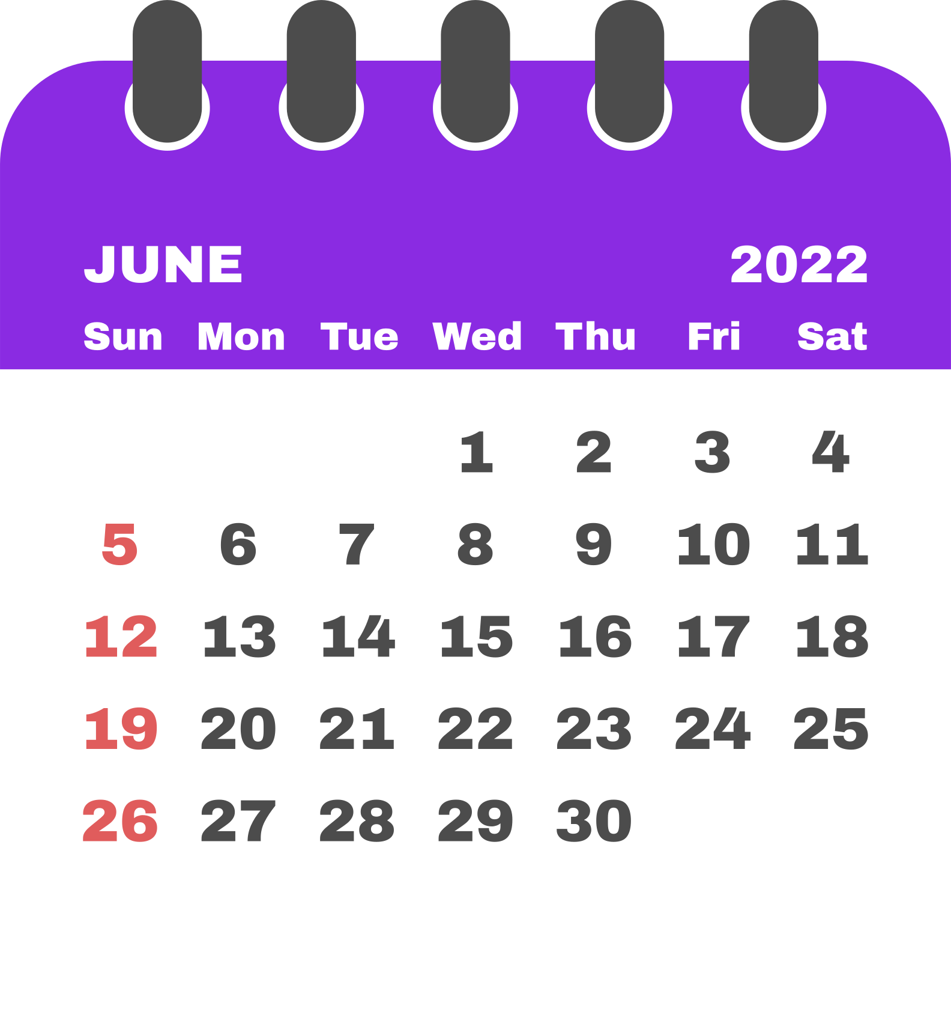
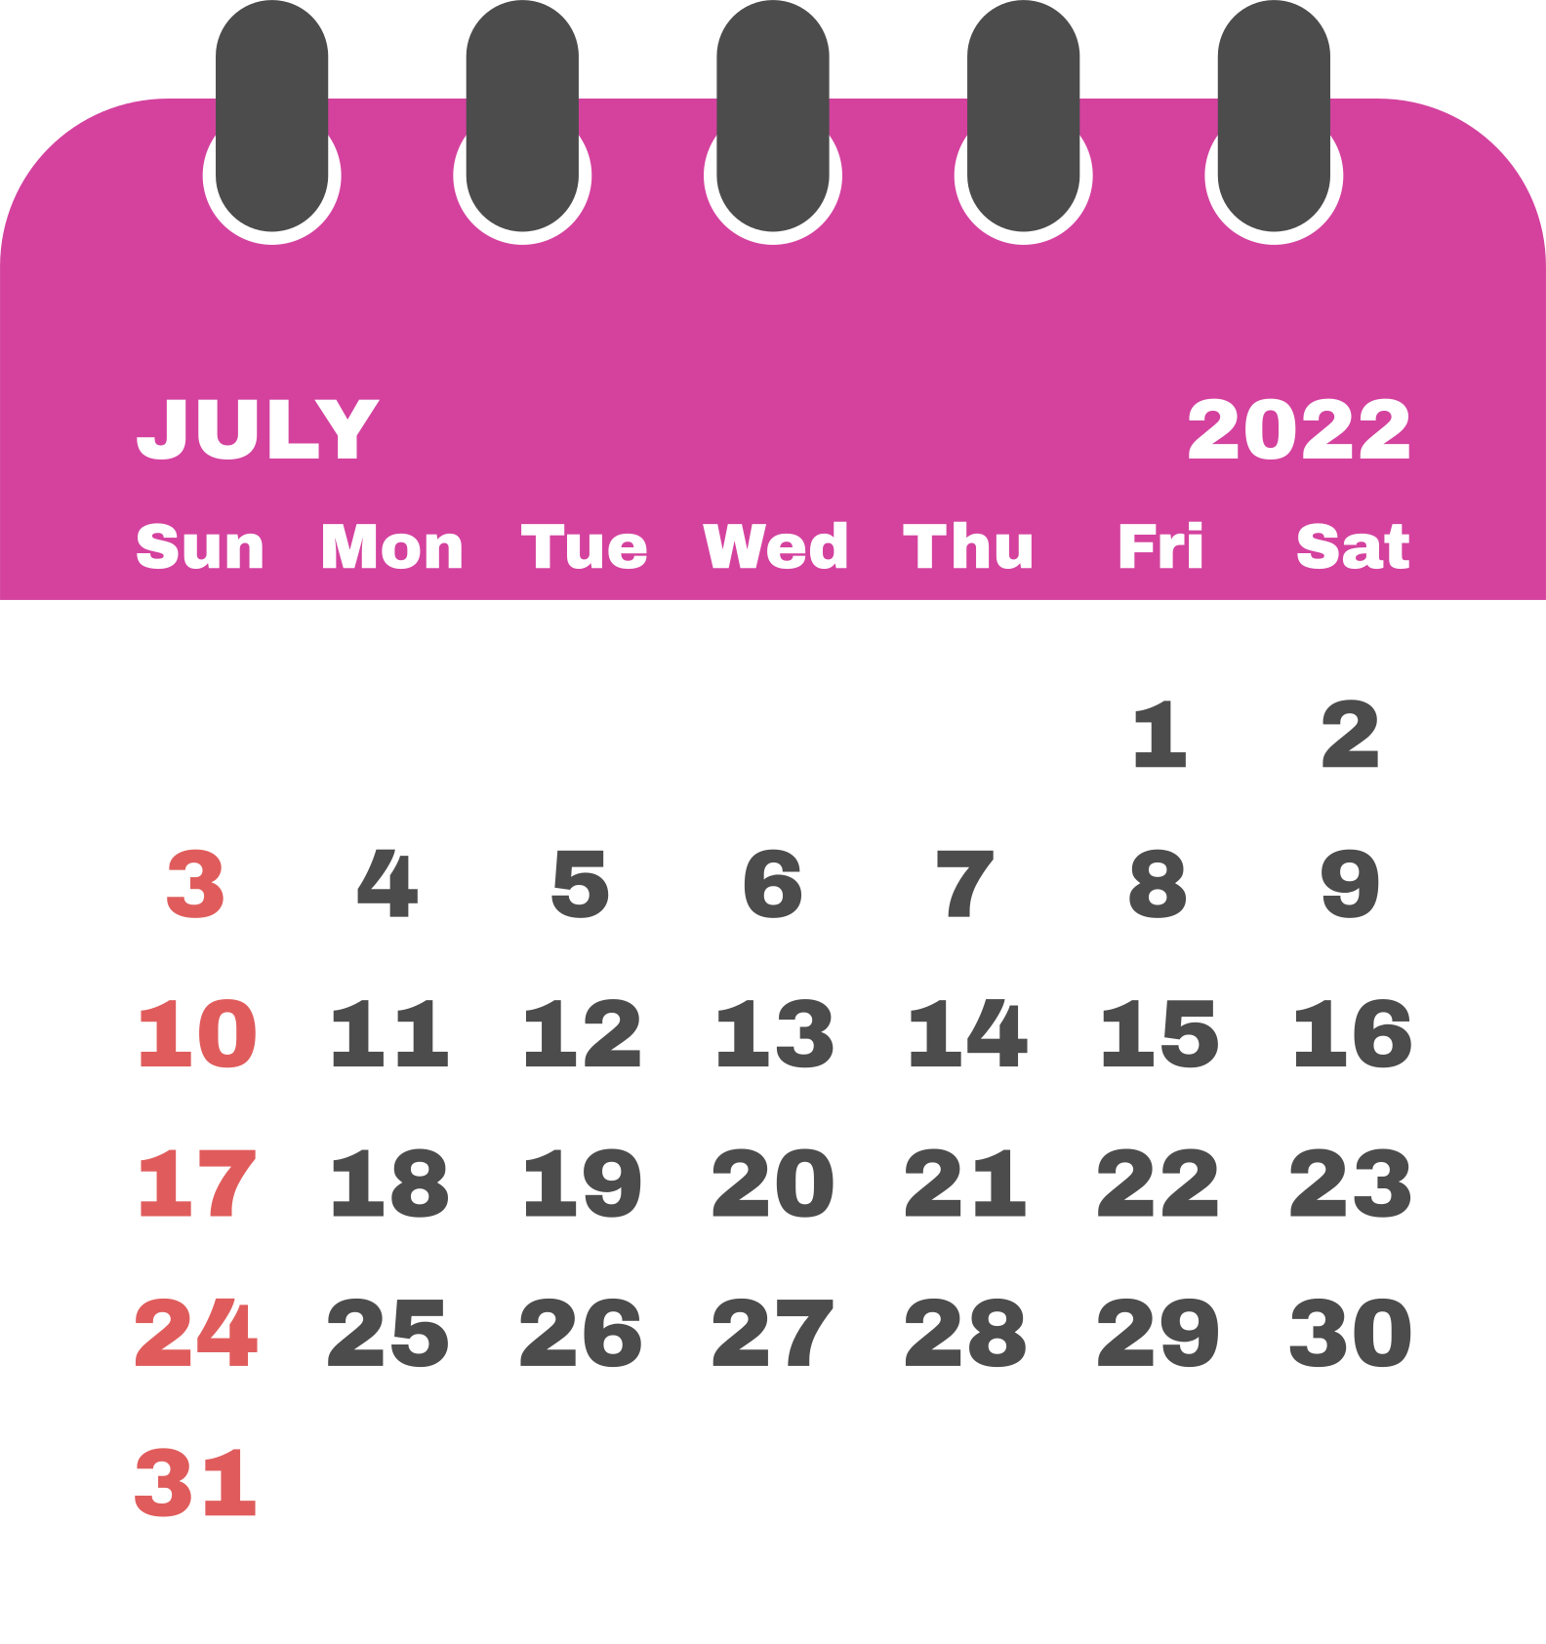
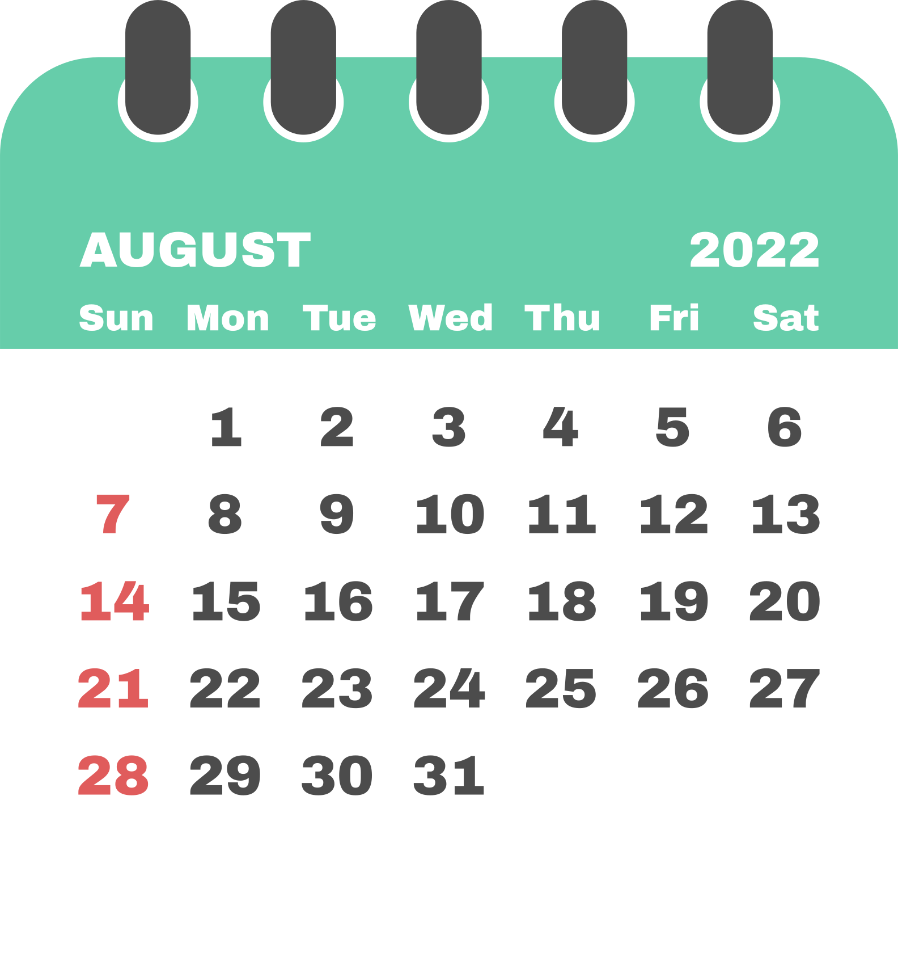
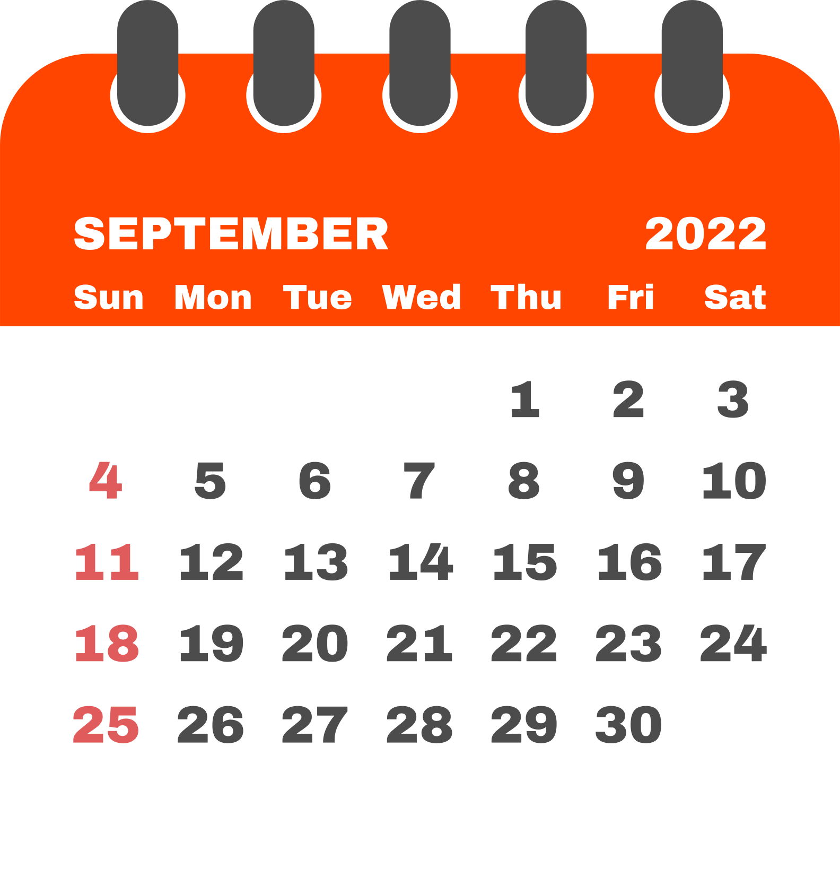
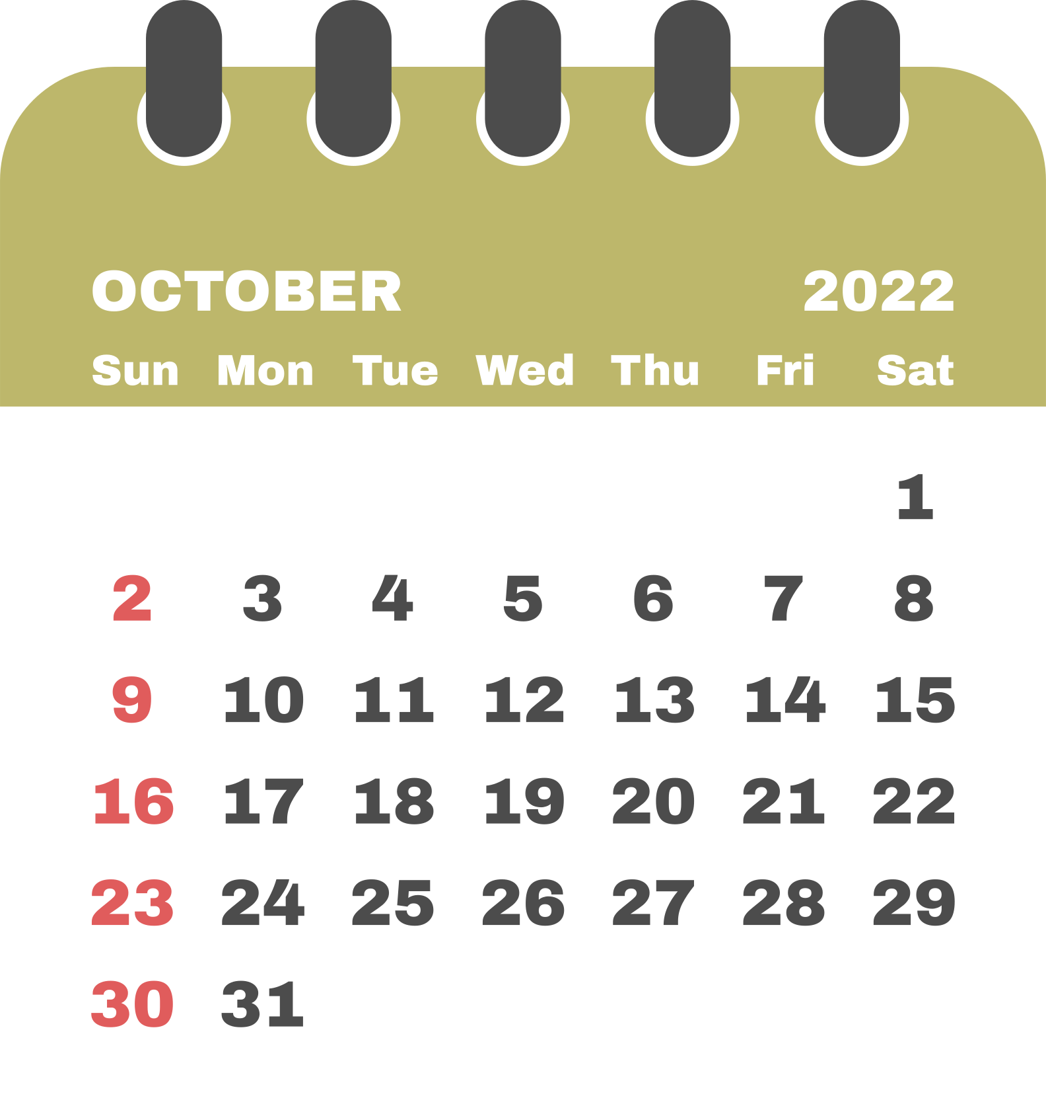
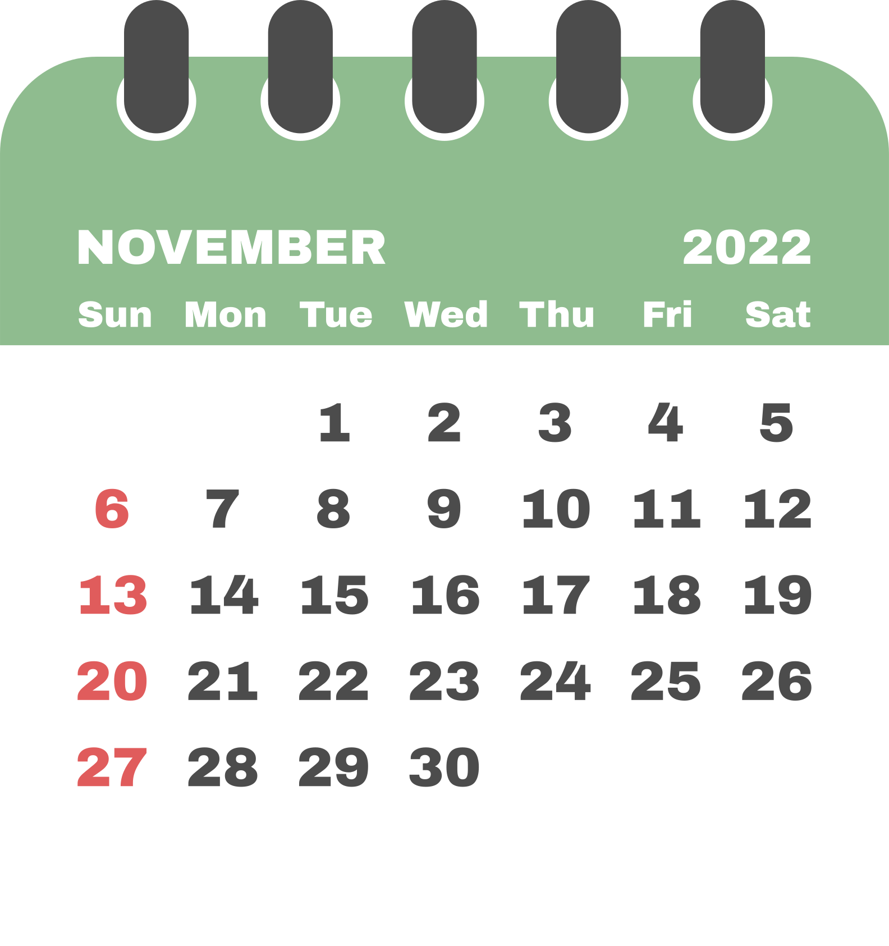
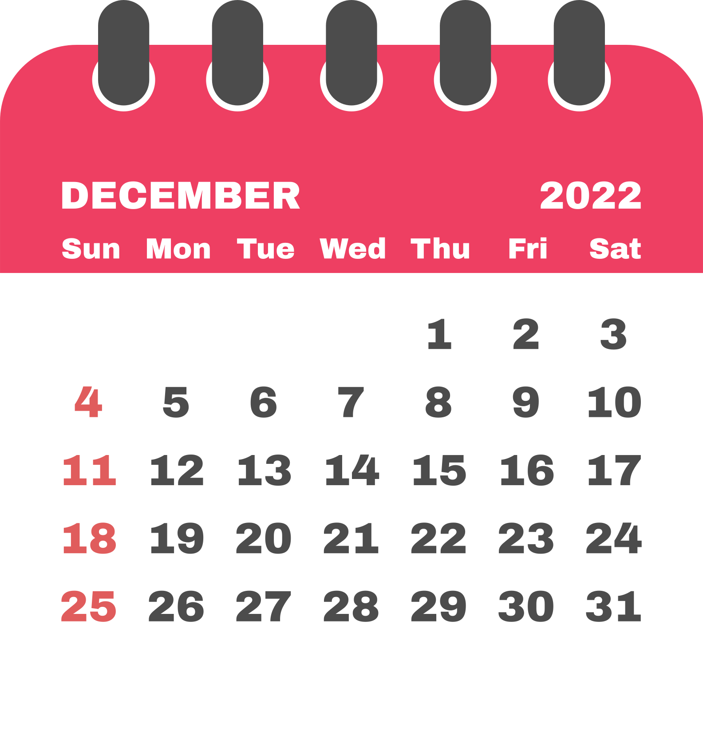

Slide 14
Jan
Feb
Mar
Apr
May
Jun
Jul
Aug
Sep
Oct
Nov
Dec
Band Camp Schedule
August
7a-11a - Outside
Lunch
12-4p - Inside
Dinner Break on your own
6-8p - Outside*** (on specific days)

Slide 15
Jan
Feb
Mar
Apr
May
Jun
Jul
Aug
Sep
Oct
Nov
Dec
Fall Weekly Schedule
MONDAY
TUESDAY
WEDNESDAY
THURSDAY
FRIDAY
SATURDAY
TUESDAY
WEDNESDAY
THURSDAY
FRIDAY
Rehearsal 7-8:30am Mon-Fri
Football Game Fri.
Contest All Day Sat. (Sept.-Nov.)

Slide 16
Jan
Feb
Mar
Apr
May
Jun
Jul
Aug
Sep
Oct
Nov
Dec
Friday Football Day
4:20 - school dismisses
Home Game - rehearsal 4:30-5
Change into Uniform and eat dinner (provided) 5-5:45
March to Stadium - 6
Kickoff - 7
Half Time - 8
Game ends - 10
Dismiss - 11

Slide 17
Jan
Feb
Mar
Apr
May
Jun
Jul
Aug
Sep
Oct
Nov
Dec
Saturday Contest Day
Arrive for Rehearsal 4 -5 hours before performance time
Performance
Lunch/Dinner (provided)
Prelims Announcement
Finals Performance
Travel to SHS
Dismiss
In short, contests are an ALL DAY event

Slide 18
Jan
Feb
Mar
Apr
May
Jun
Jul
Aug
Sep
Oct
Nov
Dec
After Marching Band Schedule
MONDAY
TUESDAY
WEDNESDAY
THURSDAY
FRIDAY
SATURDAY
TUESDAY
WEDNESDAY
THURSDAY
FRIDAY
November Band Auditions
December Winter Concert
All-Region & SHS Musical

Slide 19
Jan
Feb
Mar
Apr
May
Jun
Jul
Aug
Sep
Oct
Nov
Dec
Spring Schedule
MONDAY
TUESDAY
WEDNESDAY
THURSDAY
FRIDAY
SATURDAY
TUESDAY
WEDNESDAY
THURSDAY
FRIDAY
Sectionals Before/After School 1x a week
Indoor Drumline/Winterguard Rehearsals in evenings
Indoor Drumline/Winterguard Contests on Weekends

Slide 20
Jan
Feb
Mar
Apr
May
Jun
Jul
Aug
Sep
Oct
Nov
Dec
Spring Schedule
MONDAY
TUESDAY
WEDNESDAY
THURSDAY
FRIDAY
SATURDAY
TUESDAY
WEDNESDAY
THURSDAY
FRIDAY
Pre-UIL Concert after Spring Break
UIL April
Band Auditions late April
Solo/Ensemble in May
Band Banquet in May

Slide 21
Question
02
It's raining? That means no rehearsal...right?
Wrong! We have great facilities and will rehearse inside!

Slide 22
Question
03
I'm in athletics/other activity? What if they meet at the same time?
Communication is key, and is your responsibility. We work well with coaches and work together to give students the maximum opportunities at SHS. When you communicate, we can all plan ahead and split time 50/50.

Slide 23
Question
04
Is there a grade requirement for band to participate?
For marching band, there is the UIL No Pass No Play Rule.
All students must be passing ALL classes each 6 weeks to participate at games & contests.

Slide 24
Timeline to 2022-2023
Becoming a SOS Member
Phase 2 Registration
May 14
Phase 3 Registration
August TBD
Phase 1 Registration
March 5, 11a-4p
1
3
5
7
Band 101
February 22
2
Band Audition
April 18-20
4
9th Grade Camp
6
Band Camp
July 25 - August 12

Slide 25
Question
05
What does an audition look like?
You will play 1 or 2 excerpts from music to demonstrate your playing skill.
Everyone makes the band. This helps us to place you in one of the 3 class periods.

Slide 26
Phases of Registration
MARCH 5 - 11AM-4PM
AUGUST TBD
In-person at SHS
Complete Google Intake Form
Pay $100 Deposit
Purchase extra items
Uniform Fitting
Continue making payments on band dues. 50% paid.
MAY 14
CAMPS
Complete Fine Arts RankOne release forms online
Window to turn in physical = May 1-August1. Every student is required to complete a NEW physical each year. Send to Mrs. Holley
Make monthly payments on band dues
9th grade camp in May/June (optional)
Fit & Fun camps Tues/Thurs during Summer (optional)
Drum/Guard Camp (mandatory) - *July 18 week
Band Camp (mandatory) - *July 25 - August 12
SPIRIT OF SAGINAW BAND

Slide 27
THE FUN PART
$$$

Slide 28
01
02
Returning Band/Percussion
New Band/Percussion
$520
$575
03
04
Returning Color Guard
New Color Guard
$530
$725
Payment Plans Available. Drafts taken on the 20th day of the month.
All dues MUST be paid by November 1.
Financial Aid available - need letter from the School District or other government agency no later than May 11.
FA total dues = $300
*** Indoor Drumline & Winter Guard have separate dues in the Spring

Slide 29
Receive a 5% discount when paid in FULL!
$100 deposit due March 5 in person.
Mail payments to the Booster PO Box or Pay Online with automatic withdrawals each month after.
Saginaw Band Boosters
900 N Blue Mound Rd Ste#144-120
Saginaw, TX 76131

Slide 30
Additional Items
$50 Instrument Rental for:
Oboe
Bassoon
bass clarinet
Tenor/Baritone saxophone
French horn/Mellophone
Euphonium/Baritone
Tuba/Sousaphone
Percussion
Extra shirts
Band Bag
Yard Sign

Slide 31
FUNDRAISING
We try not to do too much fundraising, so we have ONE main band fundraiser.
It's success helps to keep band dues as low as possible.
FanPledge Telethon
Each student collects 20 names, emails & phone numbers
Asks for pledges during a 1hour time frame in August
All proceeds go to the Spirit of Saginaw Band to bring in instruction, equipment, and other needed materials.
We average $30k raised each year.

Slide 32
VOLUNTEER WITH SOS BAND!
Hi there! My name is
Lance
and I'm your kind of parent volunteer!
Join the Band Booster Club
Volunteer to help OUR students
Attend monthly meeting on 2nd Tuesday of the month
Lead

Slide 33
VOLUNTEER
Transportation
Loading Crew
Uniforms
Concessions
Chaperone on Bus.
Help pass out water at games/contests.
Help students safely load the semi trailer with instruments & props
Size students
Clean
Hem
HUGE Fundraising for the program at football games.
Section Parent
Driver
Meals
Sponsor a section and be a role model
Uniform cleaning
Have a CDL or know someone who does? We need a driver!
Pass out food to students

Slide 34
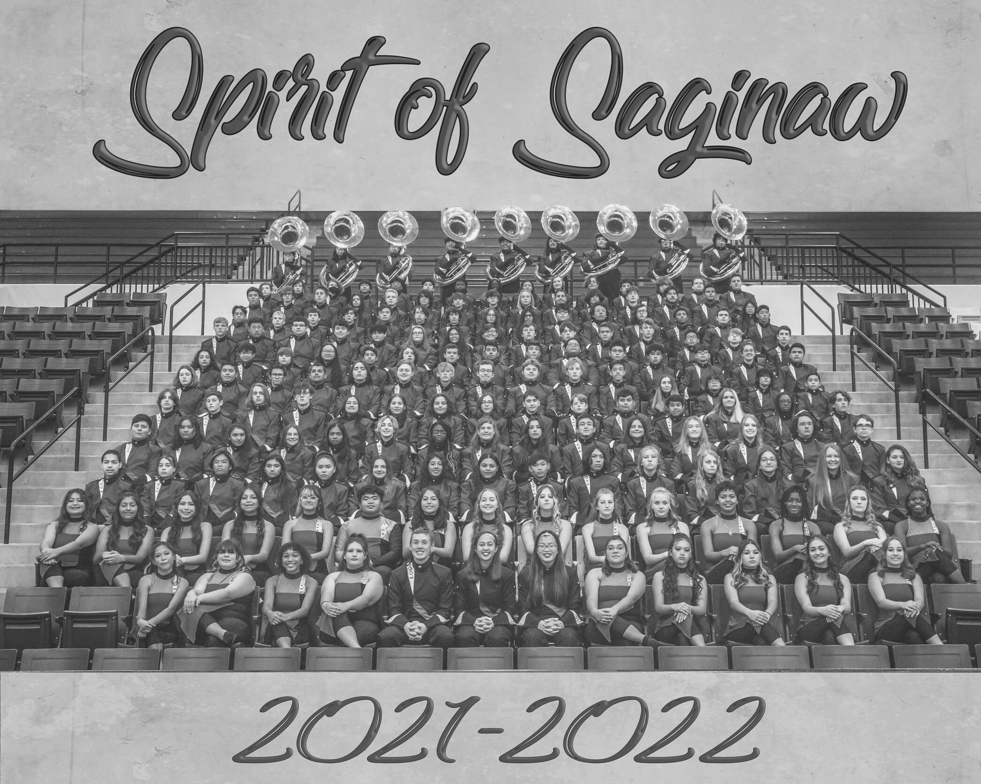
SPIRIT OF SAGINAW BAND
CONTACT US
Booster President
sosbandpresident@gmail.com
Booster Treasurer
sosband.treasurer@gmail.com

Slide 35
UNLOCK THE INFO
YOU are the model of responsibility for your student.
This includes staying informed.
What we think our kids tell us is happening in SOS Band
90%
What they actually tell us is happening in the SOS Band
33%

Slide 36
RESOURCES AT YOUR FINGERTIPS
With a large program, there is ALWAYS information available to you.
Help us help you by searching, bookmarking, and following our platforms.
Band Website
Remind Account
https://www.emsisd.com/Page/1632
https://www.emsisd.com/Page/23890
Booster Website
Growing Up
https://spiritofsaginawband.com
@Saginaw Band Boosters (FB)
@spiritofsaginaw (Insta)
@SpiritofSaginaw (Twitter)

Slide 37
What else do you want to know?
Contact Directors or Band Booster Officers if you have more questions.
Check our our website as well
Question
#

